Slide 1
LESSON 6.3
Reactivity

Slide 2
LESSON GOALS
I can predict and balance a redox reaction in solution, given its starting materials

Slide 3
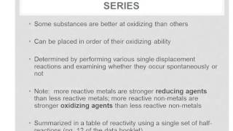
TASK 1: LEARN (MUST DO)
Individually or with a partner:
Watch the Reactivity Part 1 video
Complete the appropriate section of the Guided Note

Slide 4
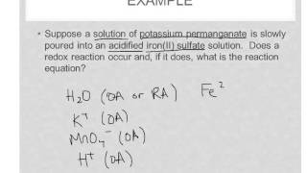
TASK 2: LEARN (MUST DO)
Individually or with a partner:
Watch the Reactivity Part 2 video
Complete the appropriate section of the Guided Note

Slide 5
TASK 3: PRACTICE
Complete the reactivity practice (answers included)
Note: There are must do and should do questions included in this practice!

Slide 6
TASK 4: MASTERY CHECK (MUST DO)
Individually:
Complete the Reactivity Mastery Check (see me when you are ready!)

